Slide 1
Quora Question Pair Detection
Thanmai Sahith Asavadi – 20114018
Nimmagadda Vasavi – 20114064
Murthati Mahibabu - 20114058

Slide 2
Introduction
Quora is an online platform to ask questions and connect with people who con-tribute unique insights and quality answers.
Given the popularity of online forums from the dawn of the internet, Quora was bound to succeed.
The scale of Quora’s success can be inferred from it’s traffic of 100s of millions of users a day.
Given the size of community, there are bound to be some duplicate or semantically same questions asked by different parties at one point or another which is simply a waste of resources for both the active seekers and writers.
So it is better to have canonical questions for everyone’s convenience.

Slide 3
Objective
In this project we’ve tried to train / develop a model to detect if a given pair of questions are duplicates of each other or not.
As there are only two classes, say duplicate, not_duplicate , we can consider this as a binary classification problem.
Which helps us to narrow down to a few possible existing algo’s that we can try, like :
Perceptron
Logistic Regression
SVM
Decision Trees

Slide 4
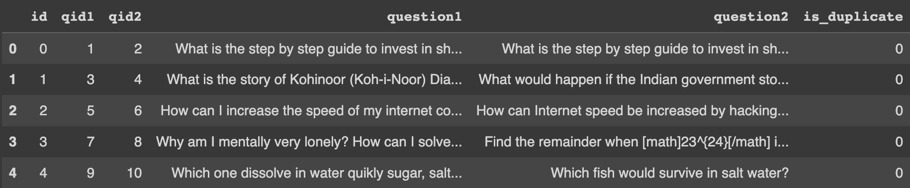
Dataset
We’ve used the ‘Quora Question Pairs’ datset from the Kaggle competition that had this task.
Dataset Structure: {id, qid1, qid2, question1, question2, is_duplicate}
Size: approx. 400k
df.head()

Slide 5
My Approach
EDA
Train on random model
Train with logistic regression
Train with SVM
Train with XGBoost.

Slide 6
Exploratory Data Analysis - EDA
Feature Extraction
Analysed and extracted some basic features which might come in handy in the future.
Some exmaples:
freq_id1, freq_id2 : Frequency of occurrence of questions
q1_len, q2_len : Length of questions
q1_wordcount, q2_wordcount : No. of words in each question
common_words_count : No. of words in common b/w q1 and q2
tot_words : Total no.of words in question 1 and 2 combined

Slide 7
Exploratory Data Analysis - EDA
Feature Analysis
Plotted some plots of different attributes vs the is_duplicate attribute to get an idea of importance of some of the attributes.
Compared violin plots to get an idea about the distance b/w the means of each classes in is_duplicate.
If the difference between mean is significantly large then we can conclude that the feature is important, since it is able to distinguish b/w classes to a significant extent.

Slide 8
Exploratory Data Analysis - EDA
Pre-processing the text
Did some preprocessing on the text data like:
Stemming the words in each sentence
Stemming: Converting multiple forms of the same word into one stem.
Removing stop words
Expanding Contractions
Lowering the case to make the case uniform
Truncating and trimming spaces to name a few

Slide 9
Exploratory Data Analysis - EDA
NLP – Based Features – Tokens
Analyse the stop words in our text corpus.
Extract some more features related to tokens like:
cwc_max, cwc_min : current word count
csc_min, csc_max : current stop-word count
ctc_min, ctc_max : current token count

Slide 10
Exploratory Data Analysis - EDA
Fuzzy Features
Fuzzy string matching is the technique of finding strings that match a pattern approximately (rather than exactly).
Compared various fuzzy parameters like:
fuzz_ratio : Percentage of matching b/w the whole strings q1 and q2.
fuzz_partial_ratio : Percentage of matching b/w the partial strings q1 and q2.
fuzz_sort_ratio : Percentage of matching b/w strings q1, q2 ignoring order of the words.
fuzz_set_ratio : Percentage of matching b/w strings q1, q2 ignoring duplicate occurances.

Slide 11
Exploratory Data Analysis - EDA
Fuzzy Feature Analysis
Performed Univariate analysis of the above four fuzzy features.
Plotted some violin plots and probability distributions for each of these features to get a better insight into the data.

Slide 12
Exploratory Data Analysis - EDA
Feature Analysis of NLP Features
Pair plotted some of the features like common word count and common token count to get an insight into relations b/w various variables.
Also plotted some wordclouds as part of the analysis.
Word Cloud: A word cloud (also known as a tag cloud) is a visual representation of words. Cloud creators are used to highlight popular words and phrases based on frequency and relevance. They provide you with quick and simple visual insights that can lead to more in-depth analyses. They highlight the most frequent words and thereby we can understand which words occur more frequently as part of the analysis.

Slide 13
Exploratory Data Analysis - EDA
Visualisation and Dimensionality Reduction :
Used t-SNE for dimenstionality reduction.
t-SNE is a nonlinear dimensionality reduction technique that is well suited for embedding high dimension data into lower dimensional data (2D or 3D) for data visualization.
t-SNE stands for t-distributed Stochas- tic Neighbor Embedding, which tells the following:
Stochastic → not definite but the random probability Neighbor → concerned only about retaining the variance of neighbour points. Embedding → plotting data into lower dimensions

Slide 14
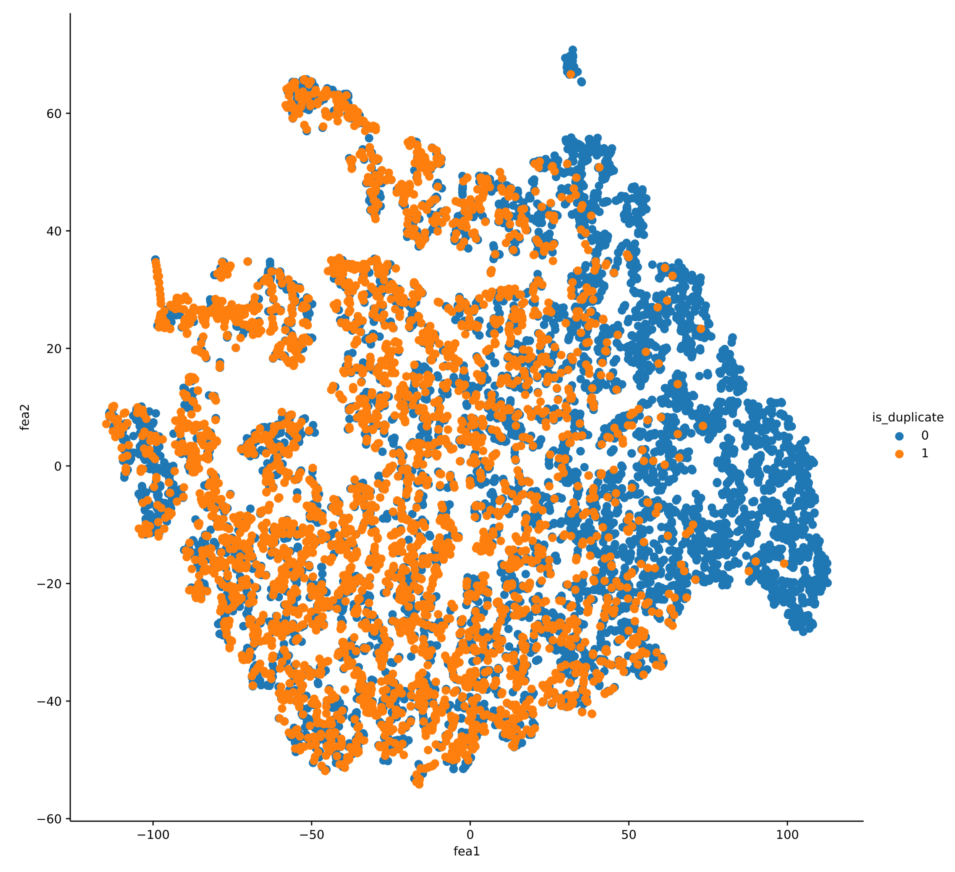

Slide 15
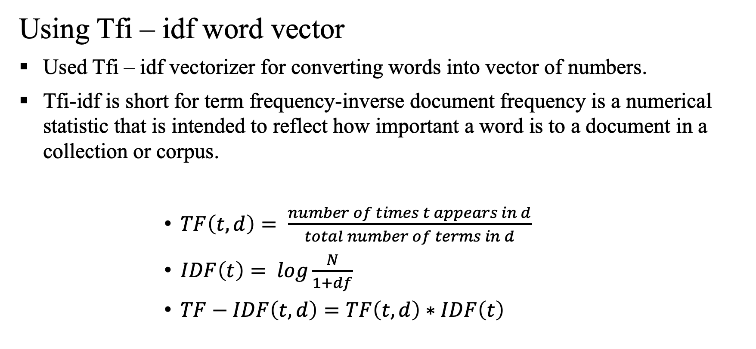
Exploratory Data Analysis - EDA
Using Tfi – idf word vector
Used Tfi – idf vectorizer for converting words into vector of numbers.
Tfi-idf is short for term frequency-inverse document frequency is a numerical statistic that is intended to reflect how important a word is to a document in a collection or corpus.
$TF\left(t, d\right)= \frac{number of times t appears in d}{total number of terms in d}$
$IDF\left(t\right)= log\frac{N}{1+df}$
$TF−IDF\left(t,d\right)=TF\left(t,d\right)∗IDF\left(t\right)$

Slide 16
Exploratory Data Analysis - EDA
Feature Selection
We’ve extracted and added many features to the dataset during the EDA phase many of which might not be very useful for our model, so we can discard them safely to reduce the noise and prevent overfitting.
Used some of sklearn’s feature selection techniques to delete some of the attributes.

Slide 17
Training
Train Test Split
We need a validation set for tuning hyperparameters to improve the performance of our model.
So, we’ve split our dataset in a 7:2:1 ratio for train and test and valid.
And we’ve split it using ‘stratify’ to make the split random, so the essence and balance of the dataset is preserved in both the subsets.

Slide 18
Training
Hyperparameter Tuning
In machine learning, hyperparameter optimization or tuning is the problem of choosing a set of optimal hyperparameters for a learning algorithm.
A hyperparameter is a parameter whose value is used to control the learning process.
Hyperparameter tuning is an essential part of controlling the behaviour of a machine learning model. If we don’t correctly tune our hyperparameters, our estimated model parameters produce suboptimal results, as they don’t minimize the loss function.
Here there is an example of graph plot between the log-loss and various values of hyperparameter used. We will choose the best hyperparameter which minimises the loss.

Slide 19
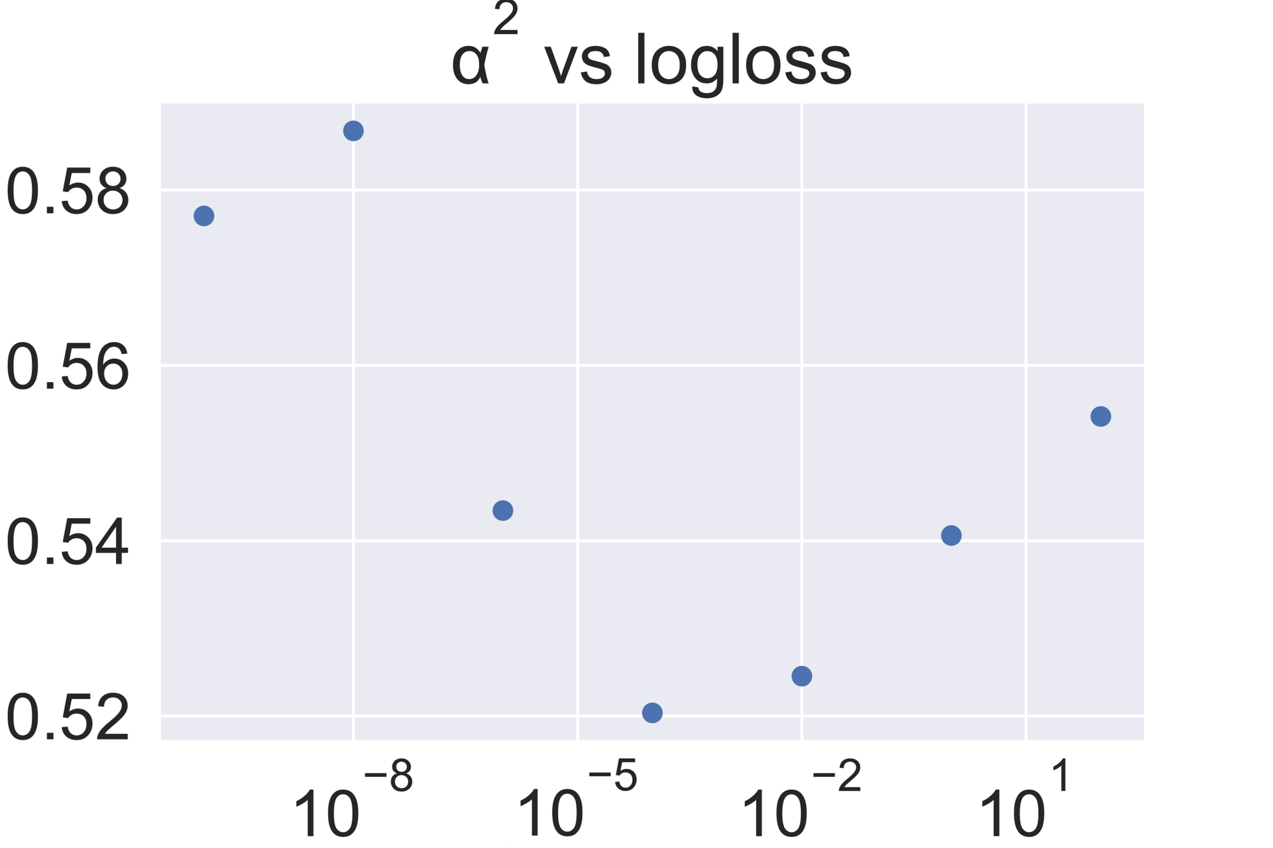

Slide 20
Training
Evaluation Metrics
Log Loss :
Log-loss is indicative of how close the prediction probability is to the corresponding actual/true value (0 or 1 in case of binary classification).
The more the predicted probability diverges from the actual value, the higher is the log-loss value.
Confusion Matrix :
An NxN table that aggregates a classification model’s correct and incorrect guesses.
One axis of a confusion matrix is the label that the model predicted, and the other axis is the ground truth. N represents the number of classes.
For example, here is a sample confusion matrix for a binary classification model.

Slide 21
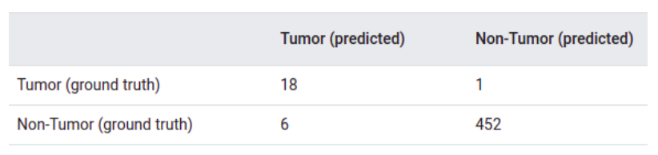

Slide 22
Training
Training a random model
Used a random guesser to get a better understanding of log loss and confusion matrix behaviour for our dataset.
Log loss on Test Data using Random Model 0.8853319606206358

Slide 23
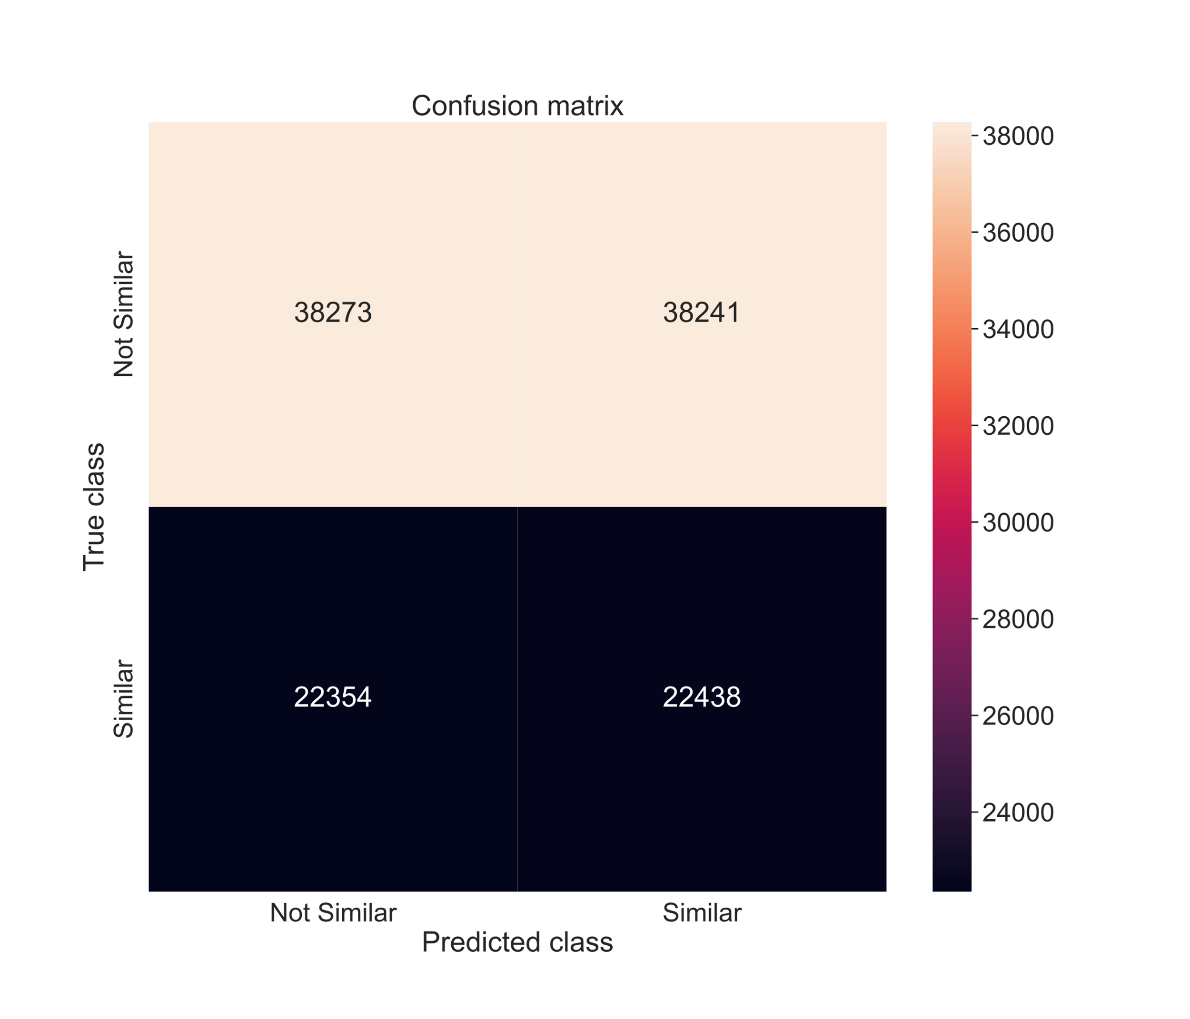

Slide 24
Training
Logistic Regression
Logistic Regression models the probability of an outcome given input.
It is generally used for binary classification.
In this model we use sigmoid function to define conditional probability.
Now firstly we need to find optimal line which gives a sigmoid function which indeed fits the train data and also performs well over training data.
So we need to determine optimal weights (w^{T}) which minimises log loss, for that we use stochastic gradient descent. In stochastic gradient we start from random value of weights and then move towards the optimal weights step by step.
Each step size might be different. If we are closing towards optimal weights then step size decreases or if we are far away step size would be more.
The variation in step size depends on current weights and a hyperparameter termed learning rate.
So varying learning rate might gives optimal results.
So, we’ve tried tuning alpha by trying out many values and choosing the one that gives the minimal log loss.

Slide 25
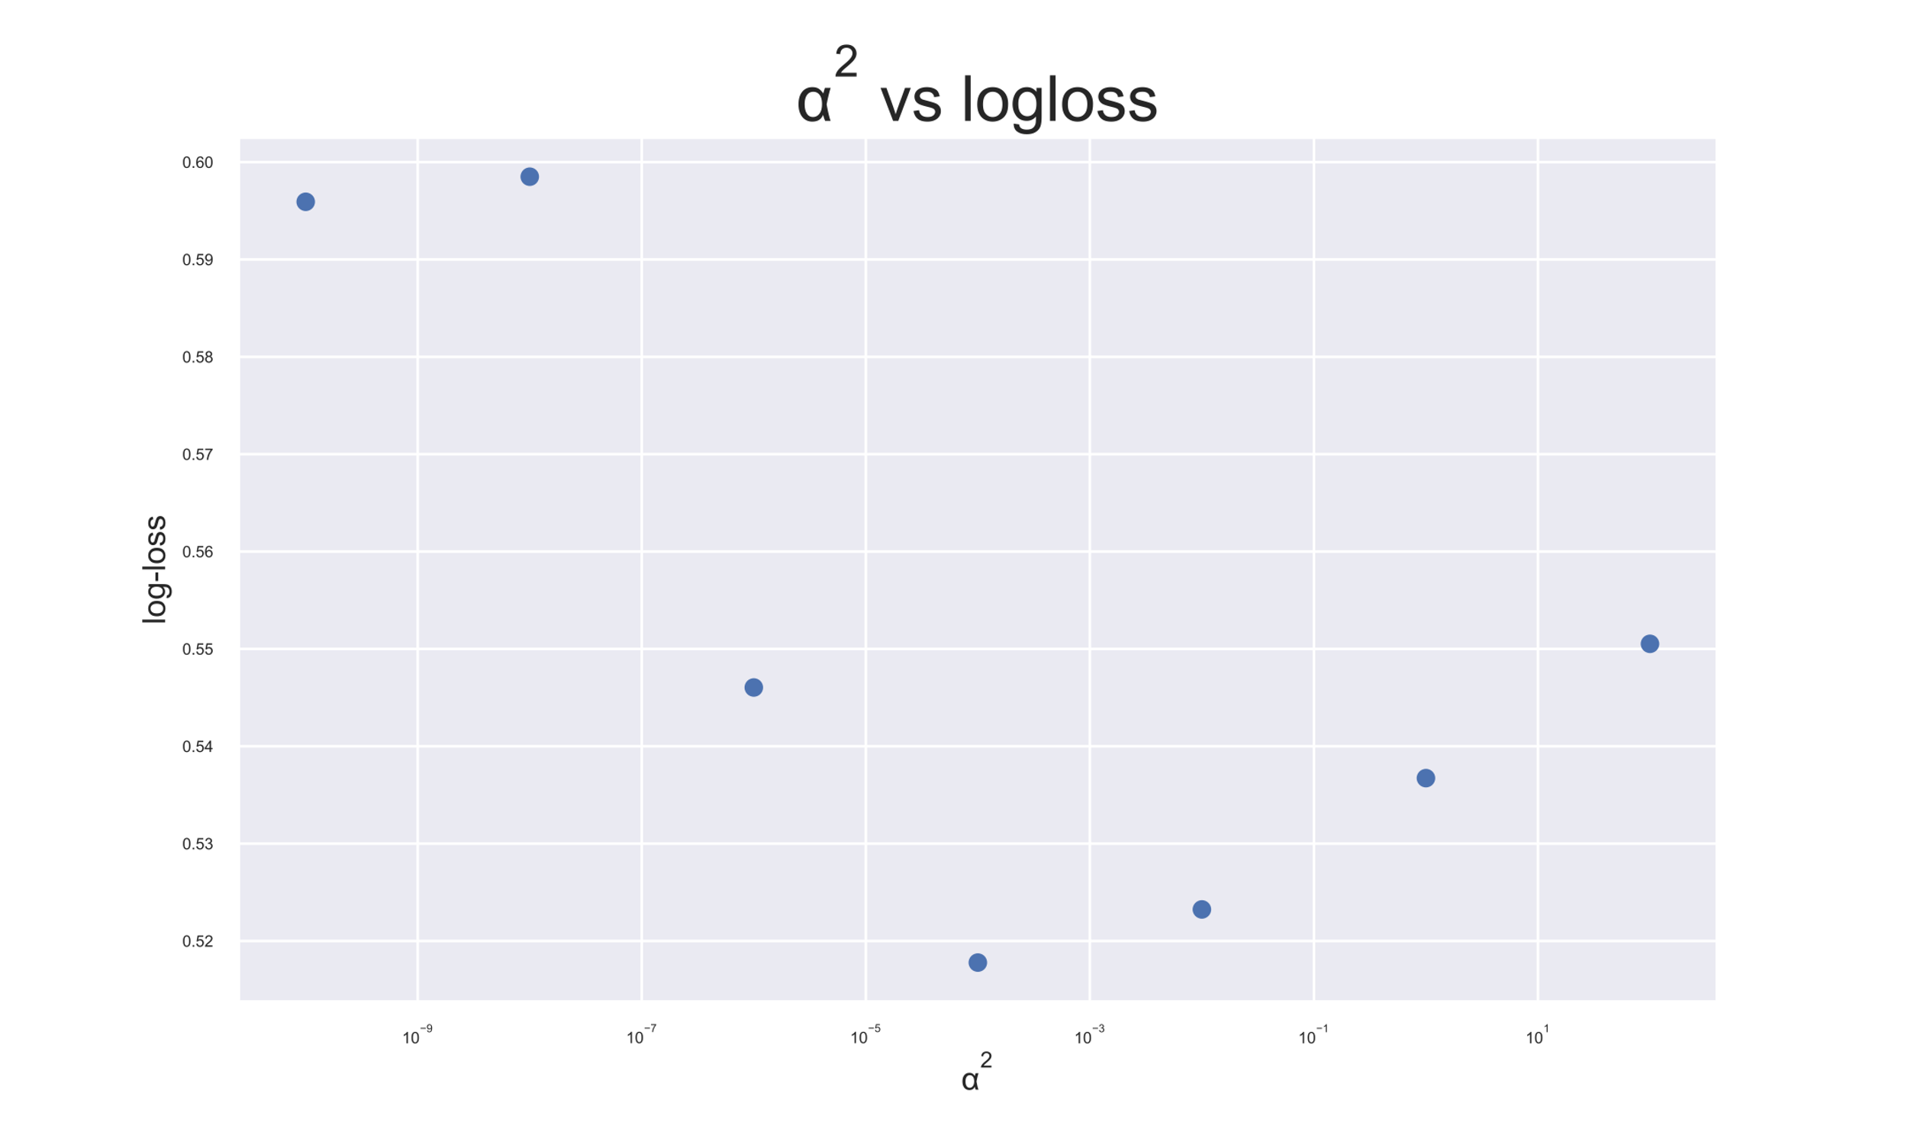
Hyper parameter tuning for logistic regression

Slide 26
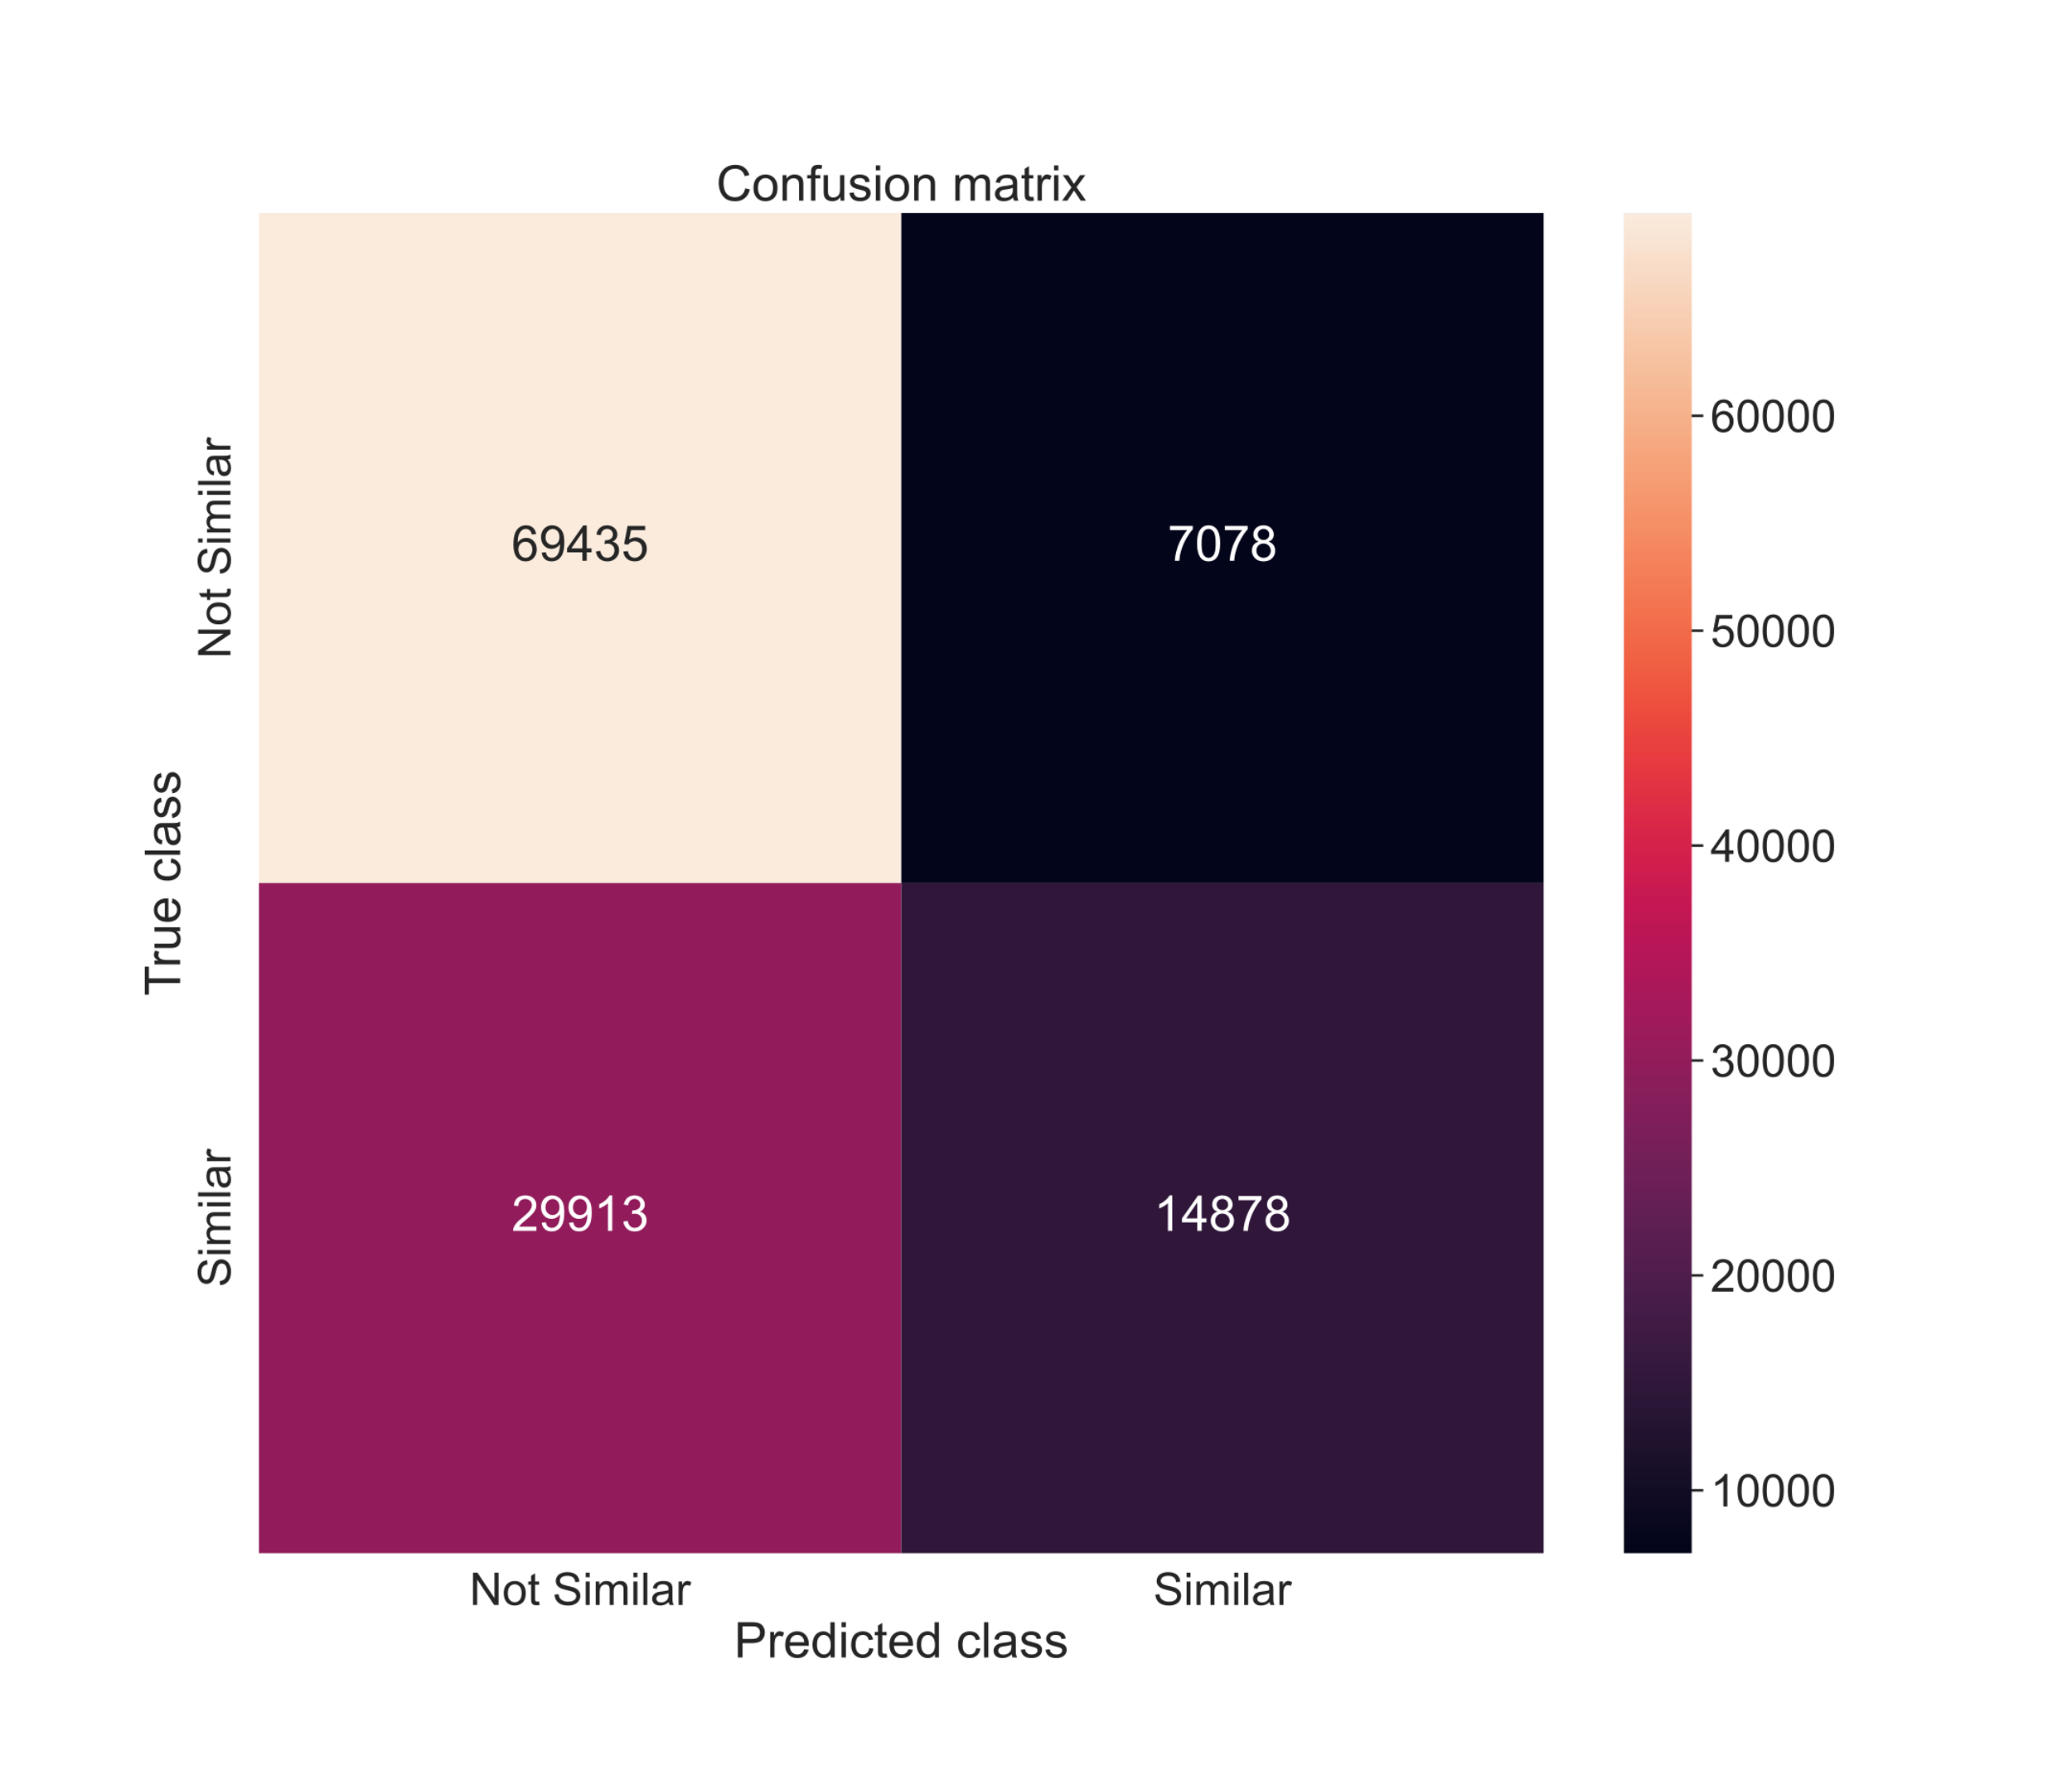
Log loss : 0.5469825829409015
Accuracy : 69.5%
Confusion matrix for Logistic Regression

Slide 27
Training
Support Vector Machine - SVM
Support Vector Machine(SVM) is a supervised machine learning algorithm used for both classification and regression.
The objective of SVM algorithm is to find a hyper- plane in an N-dimensional space that distinctly classifies the data points.
The dimension of the hyperplane depends upon the number of features. If the number of input features is two, then the hyper- plane is just a line. If the number of input features is three, then the hyperplane becomes a 2-D plane.
We have trained a Support Vector Machine with the sigmoid kernel and did some hyperparameter tuning to optimise the performance / accuracy.

Slide 28

Hyper parameter tuning for SVM

Slide 29
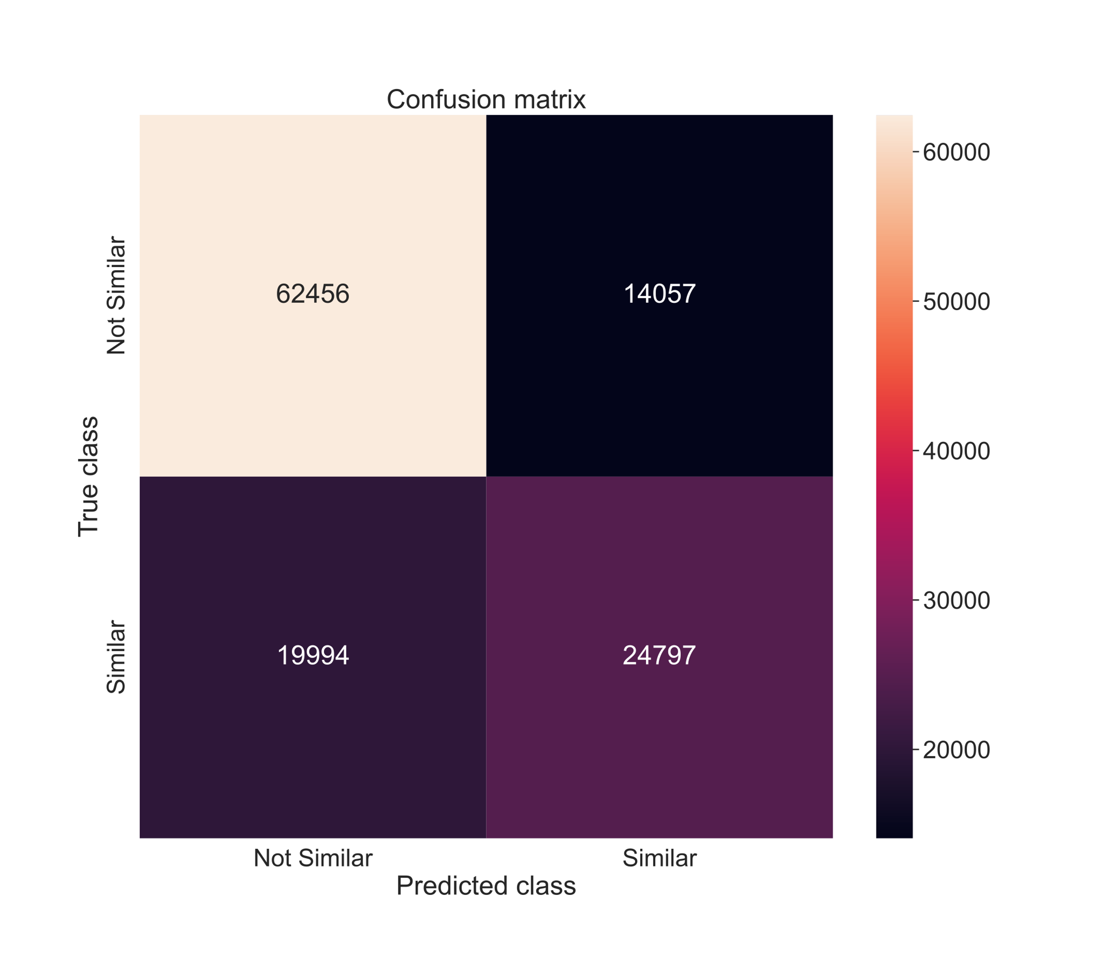
Log loss : 0.5177835174239483
Accuracy : 71.93%
Confusion matrix for SVM

Slide 30
Training
XGBoost
XG boost is an extreme gradient boosting technique for decision trees.
In this algorithm, decision trees are created in sequential form. Weights play an important role in XGBoost.
Weights are assigned to all the independent variables which are then fed into the decision tree which predicts results.
The weight of variables predicted wrong by the tree is increased and these variables are then fed to the second decision tree.
These individual classifiers / predictors then ensemble to give a strong and more precise model. So, simply speaking it is an ensemble learning model.
It can work on regression, classification, ranking, and userdefined prediction problems.

Slide 31
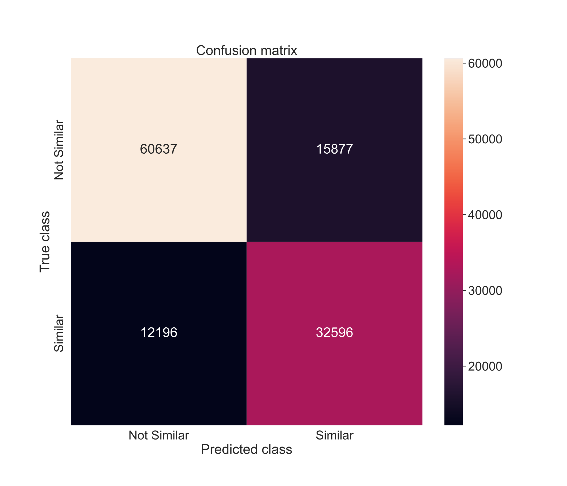
Log loss : 0.43958440769961377
Accuracy : 76.97%
Confusion matrix for XGBoost

Slide 32
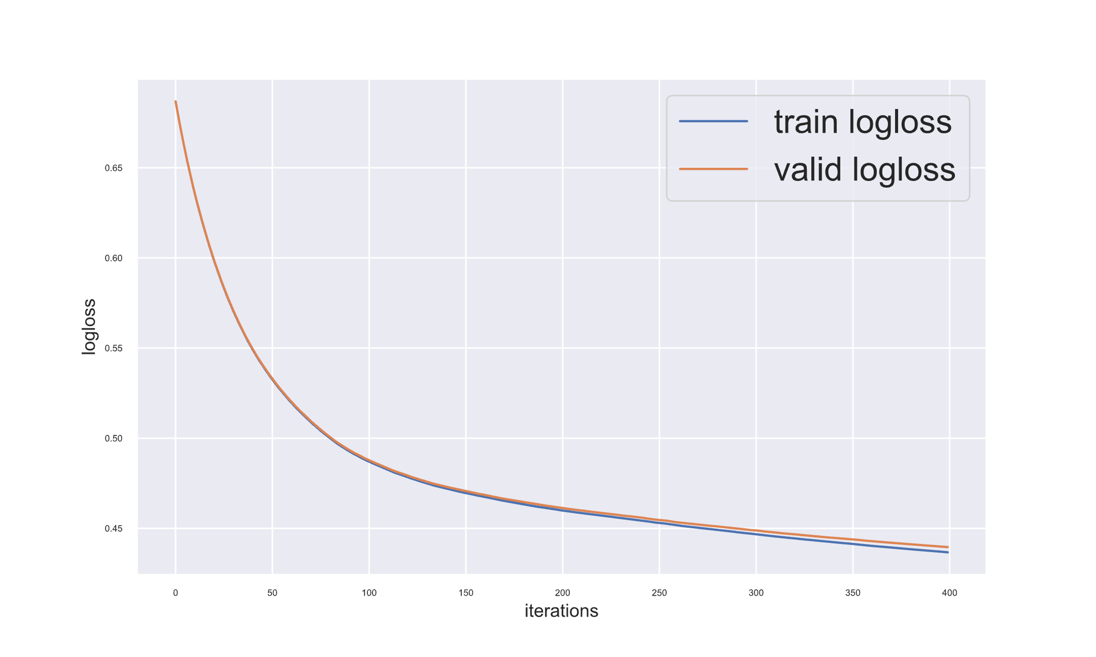
Train vs Validation log loss over iterations

Slide 33
Conclusion
To conclude, we’ve analysed, cleaned, processed the data at the beginning followed by trying various models to check for their results and performance for the given task.
In the end, the observations are as follows
Log loss : Logistic Regression > SVM > XGBoost
Accuracy : XGBoost > SVM > Logistic Regression

Slide 34
THANK YOU

